Slide 1
Notions of Noise
Alican , Lucas , Gaurav, Sriram and Thomas

Slide 2
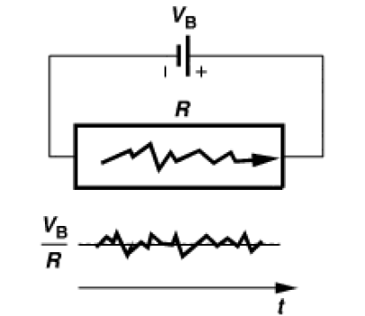
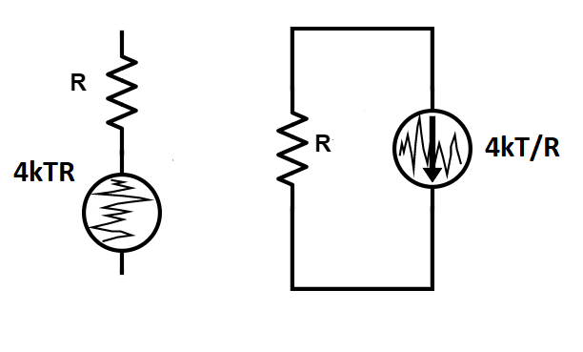
Resistor Noise
S_{in}
f
Current in resistor connected to battery fluctuates because of thermal fluctuations.
Modelled as equivalent series voltage or parallel current source.

Slide 3
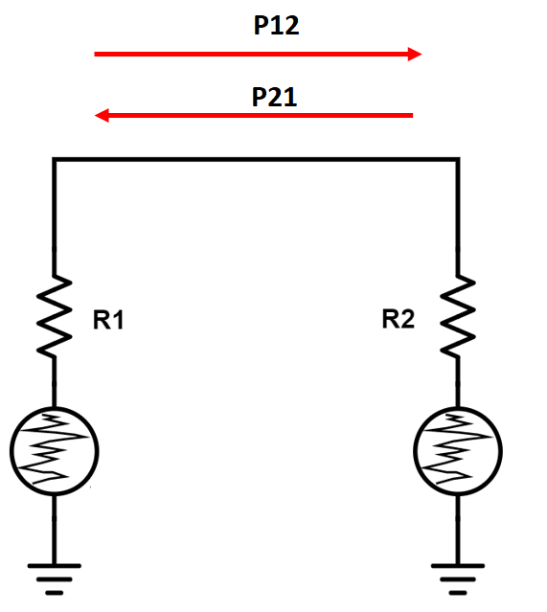
Problem 1 (10 Min)
Resistor R₁ and R₂ are connected in series.
P₁₂ is the power transferred from resistor R₁ to R₂ due to thermal noise in resistor R₁ in an arbitrary bandwidth B. Similarly P₂₁ is the power transferred from resistor R₂ to R_{1.}
Calculate P₁₂ and P₂₁ ?
What is the relationship between P₁₂ and P_{21 .}Can you comment on this?

Slide 4
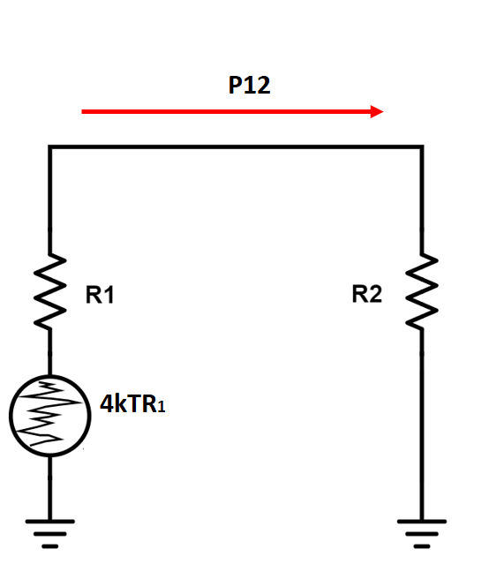
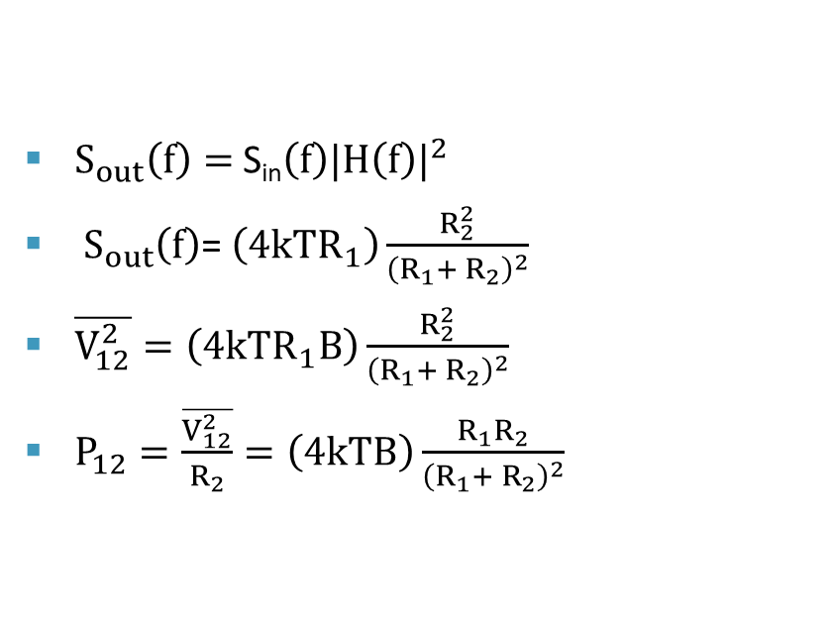
Solution 1
$S_{out}\left(f\right)=$ S_{in}$\left(f\right){|H\left(f\right)|}^{2}$
$S_{out}\left(f\right)$= $\left(4kTR_{1}\right)\frac{R_{2}^{2}}{{\left(R_{1}+ R_{2}\right)}^{2}}$
$\overline{V_{12}^{2}}=\left(4kTR_{1}B\right)\frac{R_{2}^{2}}{{\left(R_{1}+ R_{2}\right)}^{2}}$
$P_{12}=\frac{\overline{V_{12}^{2}}}{R_{2}}=\left(4kTB\right)\frac{R_{1}R_{2}}{{\left(R_{1}+ R_{2}\right)}^{2}}$

Slide 5

Solution 1
Similarly $P_{21}= \left(4kTB\right)\frac{R_{1}R_{2}}{{\left(R_{1}+ R_{2}\right)}^{2}}$
$P_{12}=P_{21}$ expected in thermodynamic equilibrium.

Slide 6
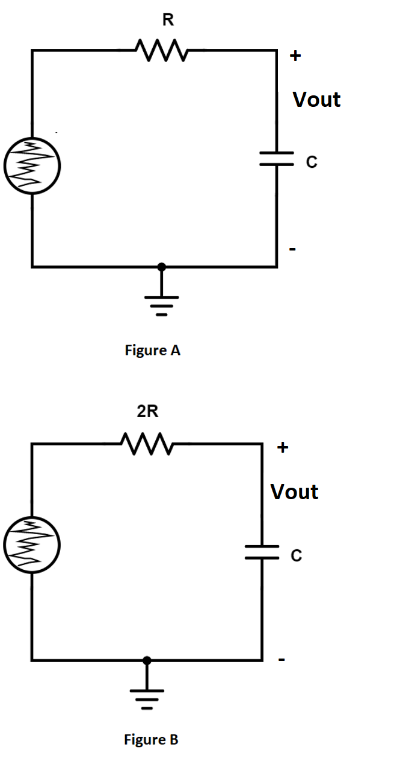
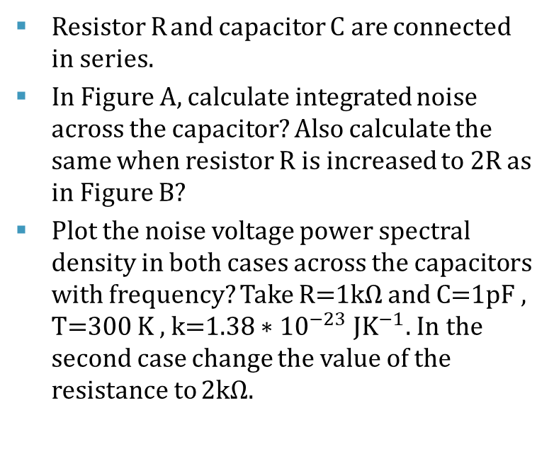
Problem 2 (10-MIN)
Resistor R and capacitor C are connected in series.
In Figure A, calculate integrated noise across the capacitor? Also calculate the same when resistor R is increased to 2R as in Figure B?
Plot the noise voltage power spectral density in both cases across the capacitors with frequency? Take R=1kΩ and C=1pF , T=300 K , k=${1.38∗10}^{−23} {JK}^{−1}.$In the second case change the value of the resistance to 2kΩ.

Slide 7
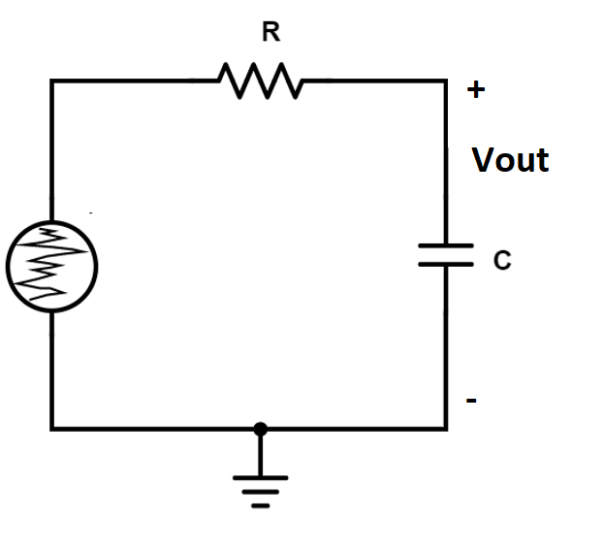
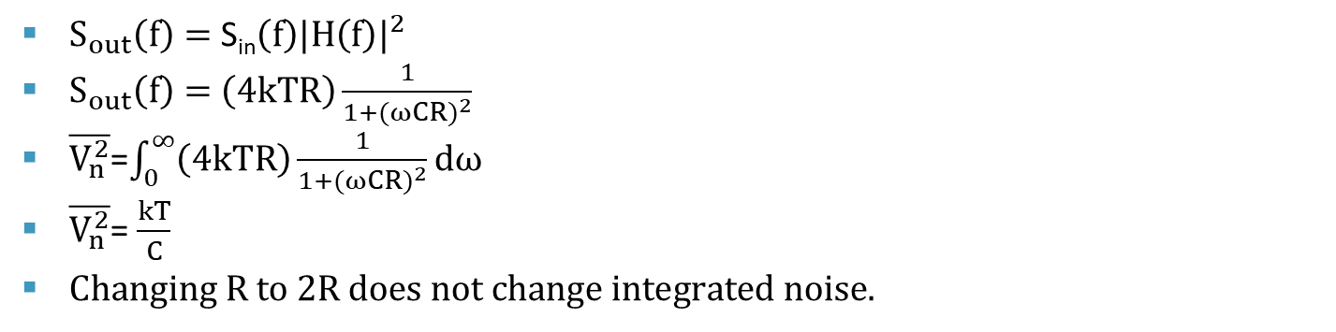
Solution 2
S_{in}
S_{in}
f
f
$S_{out}\left(f\right)=$ S_{in}$\left(f\right){|H\left(f\right)|}^{2}$
$S_{out}\left(f\right)=$ $\left(4kTR\right)\frac{1}{1+({ωCR)}^{2}}$
$\overline{V_{n}^{2}}$=$\int_{0}^{∞}{\left(4kTR\right)\frac{1}{1+({ωCR)}^{2}}}ⅆω$
$\overline{V_{n}^{2}}$= $\frac{kT}{C}$
$Changing R to 2R does not change integrated noise.$

Slide 8
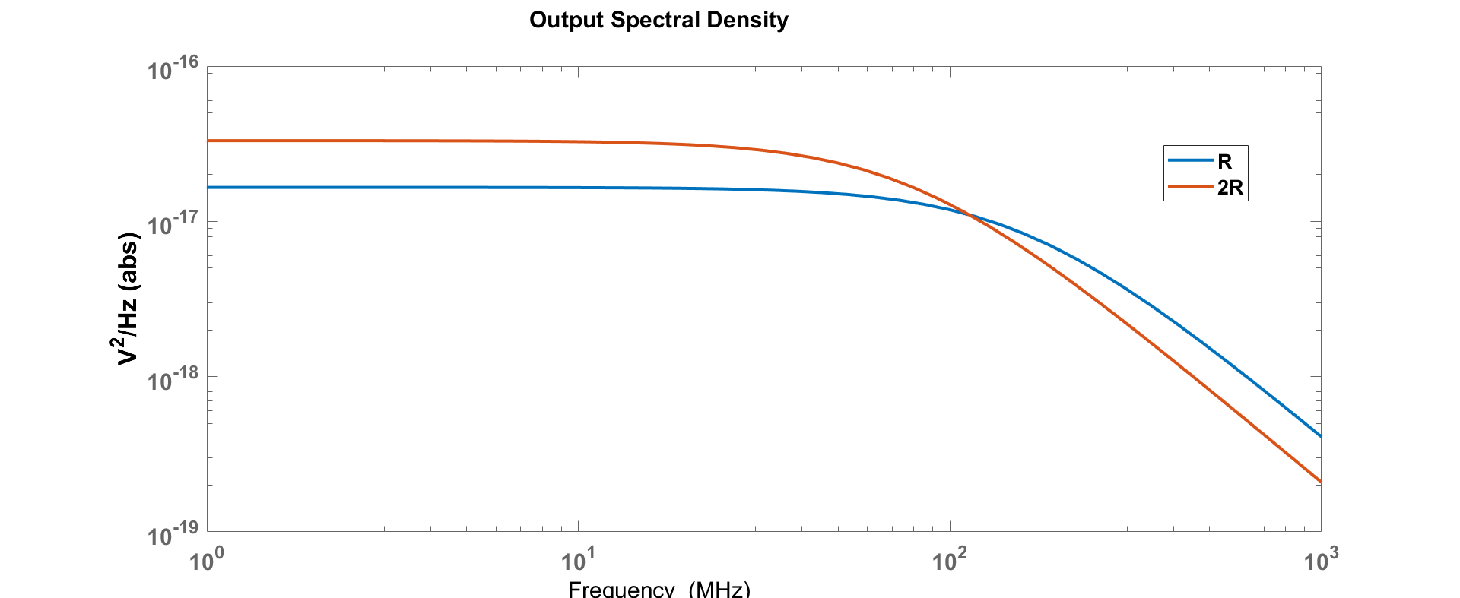
Solution 2

Slide 9
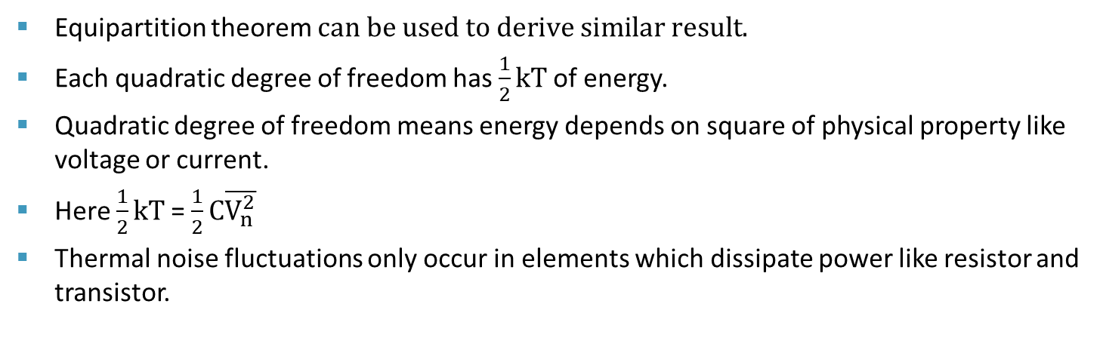
Solution 2
Equipartition theorem $can be used to derive similar result.$
Each quadratic degree of freedom has $\frac{1}{2}kT$of energy.
Quadratic degree of freedom means energy depends on square of physical property like voltage or current.
Here $\frac{1}{2}kT$= $\frac{1}{2}C\overline{V_{n}^{2}}$
Thermal noise fluctuations only occur in elements which dissipate power like resistor and transistor.

Slide 10
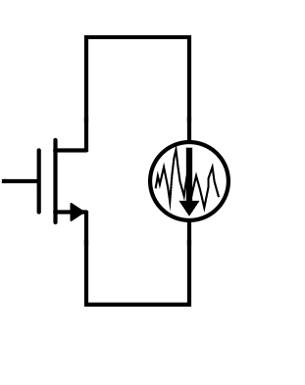
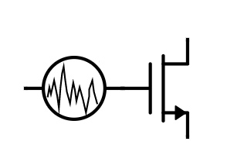


Thermal Noise in MOS transistor
Fictitious Equivalent
$$\frac{4kTγ}{gm} \frac{V^{2}}{Hz}$$
$$4kTγgm \frac{A^{2}}{Hz}$$
Noiseless

Slide 11
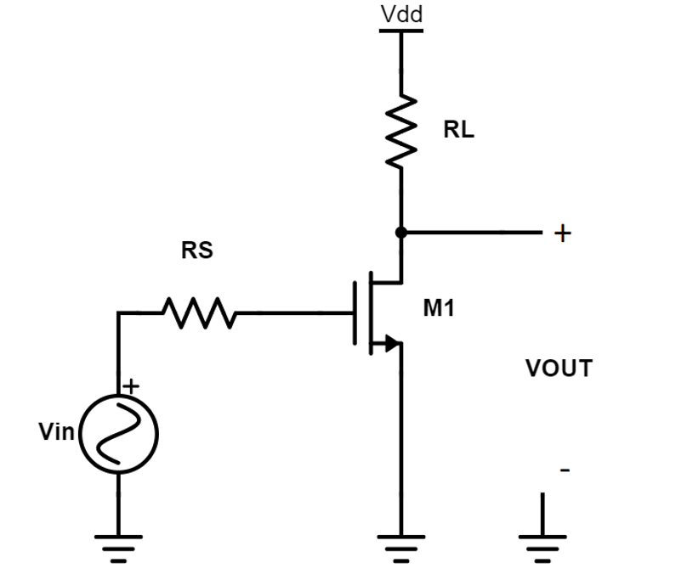
Problem 3(10-MIN)
Calculate output and input referred noise of common source amplifier?
Assume transistor properly biased with infinite output impedance and trans-conductance gm.
Consider only thermal noise for calculations.
How will you decrease by a factor of 2 the input referred thermal noise contribution of M₁ and load resistor R_{L} keeping the gain of the amplifier same ?

Slide 12
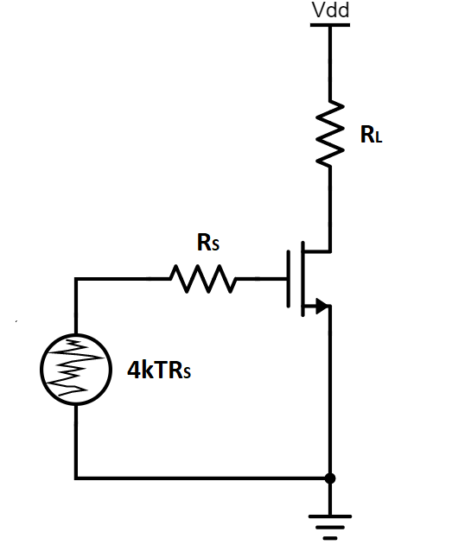
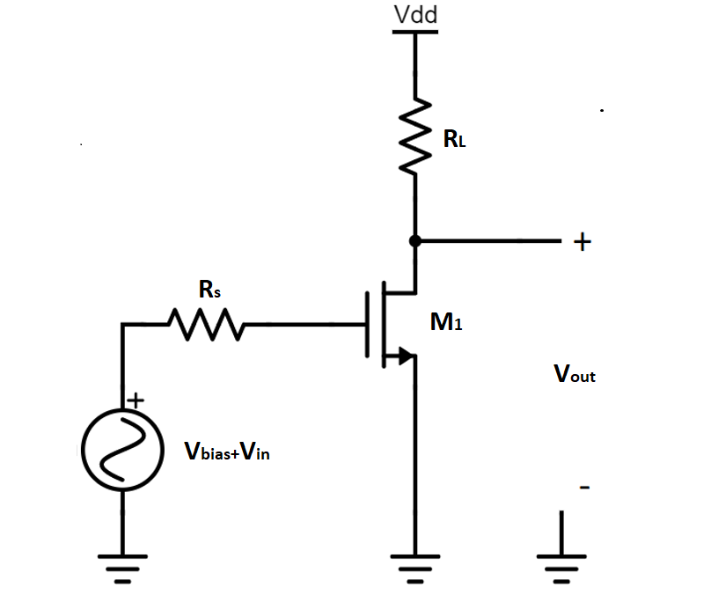
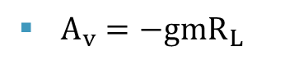


Solution 3
$$S_{R_{F}}\left(f\right)$$
$A_{v}={−gmR}_{L}$
$S_{R_{F}}\left(f\right)=4{kTR}_{s}{\left({gmR}_{L}\right)}^{2}$

Slide 13
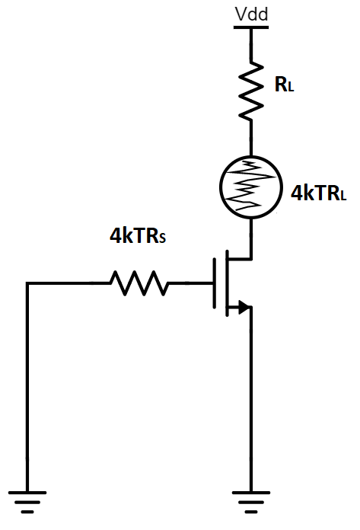
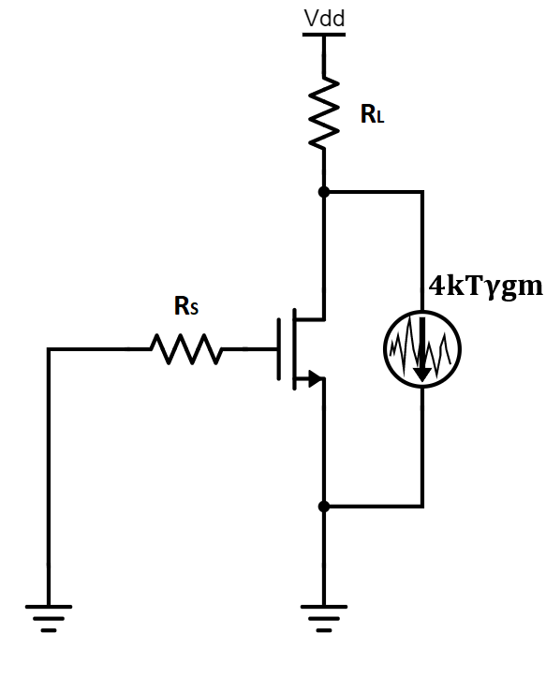




Solution 3
$$S_{M1}\left(f\right)$$
$$S_{R_{L}}\left(f\right)$$
$S_{R_{L}}\left(f\right)=4{kTR}_{L}$
$S_{M1}\left(f\right)=4kTγgmR_{L}^{2}$

Slide 14

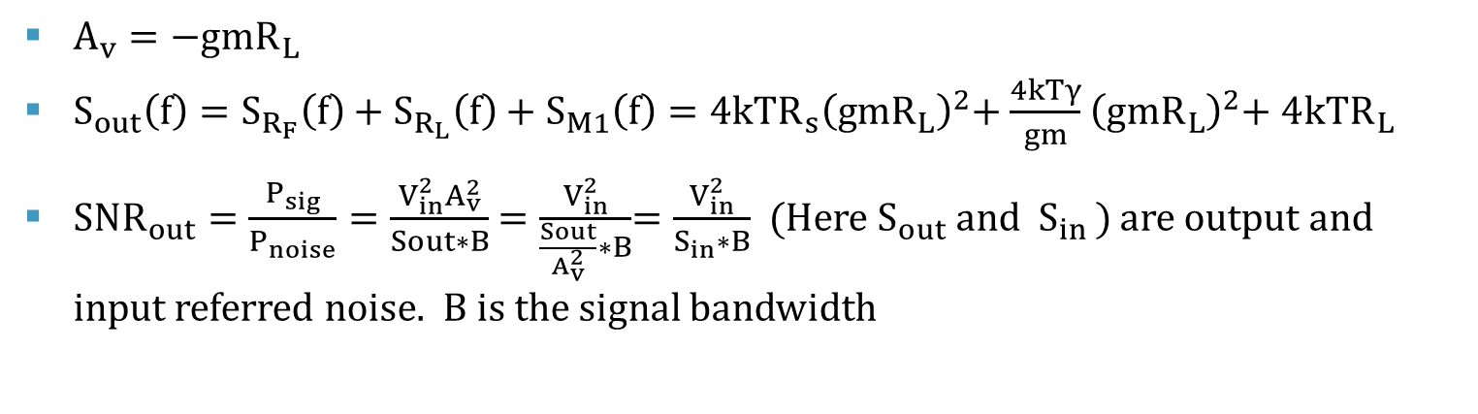

Solution 3
B
$$Signal$$
S_{in}
$$Noise Floor$$
f
$A_{v}=−{gmR}_{L}$
$S_{out}\left(f\right)=S_{R_{F}}\left(f\right)+S_{R_{L}}\left(f\right)+S_{M1}\left(f\right)=4{kTR}_{s}{\left({gmR}_{L}\right)}^{2}$+ $\frac{4kTγ}{gm}$ ${\left({gmR}_{L}\right)}^{2}$+ $4{kTR}_{L}$
$SNR_{out}=\frac{P_{sig}}{P_{noise}}=\frac{V_{in}^{2}A_{v}^{2}}{Sout∗B}$ = $\frac{V_{in}^{2}}{\frac{Sout}{A_{v}^{2}}∗B}$= $\frac{V_{in}^{2}}{S_{in}∗B}$ (Here $S_{out}$ and ${ S}_{in })$ are output and input referred noise. B is the signal bandwidth

Slide 15

Solution 3
$S_{in}\left(f\right)=\frac{S_{out}\left(f\right)}{A_{v}^{2}}=4{kTR}_{s}$+ $\frac{4kTγ}{gm}$ + $\frac{4{kTR}_{L}}{A_{v}^{2}}$
Decrease the $R_{L}$ by half and increase gm by factor of 2 will keep the gain $A_{v}$ same but will decrease input referred noise contribution by half of both transistor $M_{1 }$and $R_{L }$.

Slide 16
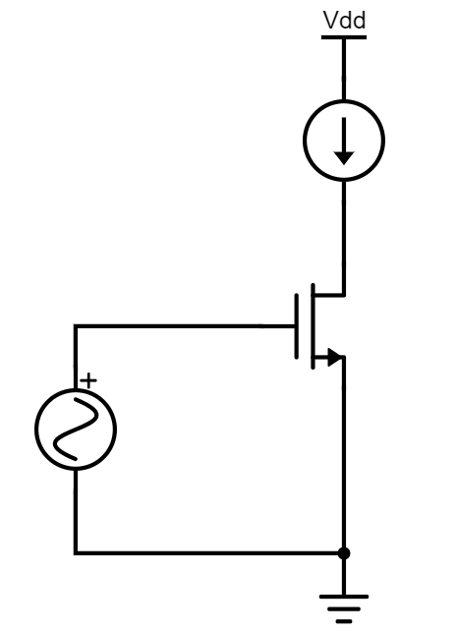
MATLAB Session1 (15MIN)

Slide 17
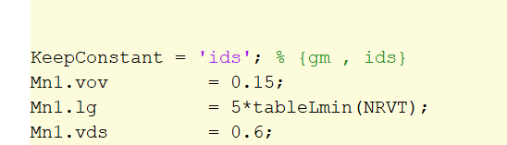
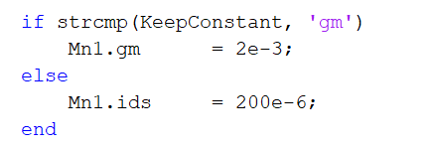

MATLAB Session1
$I_{ds}=\frac{W}{2L}μ_{n}C_{ox}V_{ov}^{2}$
$V_{ov}$, $V_{ds}$ and channel length is fixed.
$I_{ds}$ is varied by changing W.
Vary $I_{ds}$ from 50u to 1mA.
Parameter KeepConstant =‘ids’ enables computation of channel width and hence gm based of Mn1.ids parameter as shown.

Slide 18
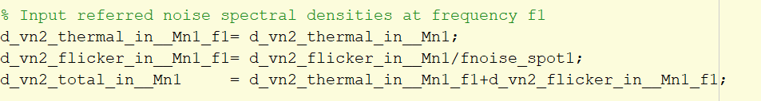
MATLAB Session1
Vary the drain current using Mn1.ids from 50u to 1mA .
Plot drain current vs gm.
Plot Transistor width vs gm.
Also plot input referred thermal noise , flicker noise vs gm.
Keep fnoise_spot1 parameter as 1Hz for now. It is the frequency at which spot noise is obtained.

Slide 19
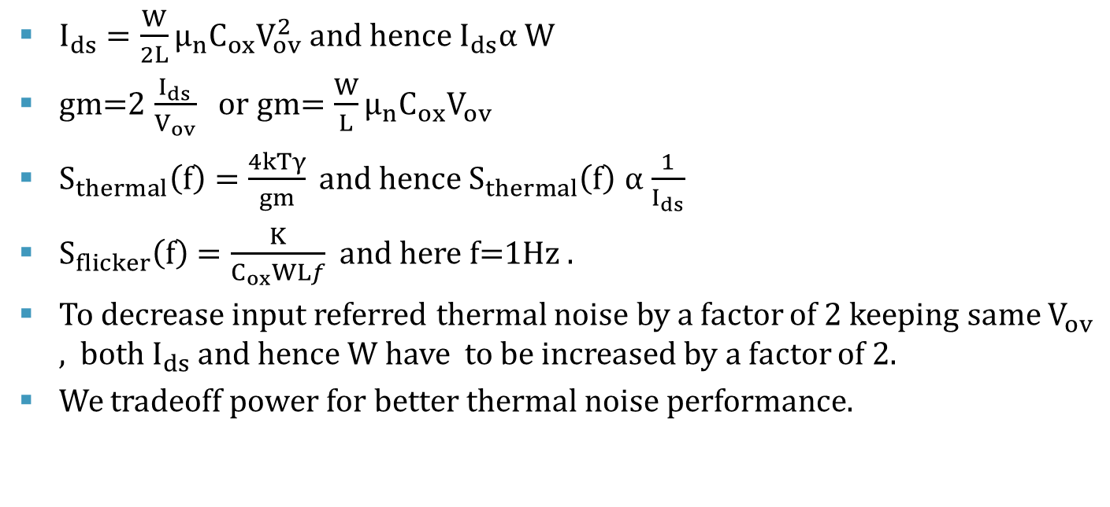
MATLAB Session1
$I_{ds}=\frac{W}{2L}μ_{n}C_{ox}V_{ov}^{2}$ and hence $I_{ds}α W$
gm=2 $\frac{I_{ds}}{V_{ov}}$ or gm= $\frac{W}{L}μ_{n}C_{ox}V_{ov}$
$S_{thermal}\left(f\right)=\frac{4kTγ}{gm} and hence{ S}_{thermal}\left(f\right)$ $α$ $\frac{1}{I_{ds}}$
$S_{flicker}\left(f\right)=\frac{K}{C_{ox}WLf}$ and here f=1Hz .
To decrease input referred thermal noise by a factor of 2 keeping same $V_{ov}$ , both $I_{ds}$ and hence W have to be increased by a factor of 2.
We tradeoff power for better thermal noise performance.

Slide 20
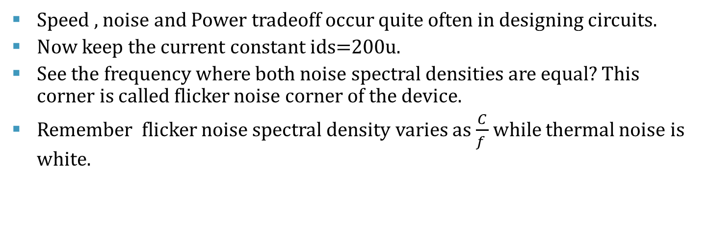
MATLAB Session1 (5 min)
Speed , noise and Power tradeoff occur quite often in designing circuits.
Now keep the current constant ids=200u.
See the frequency where both noise spectral densities are equal? This corner is called flicker noise corner of the device.
Remember flicker noise spectral density varies as $\frac{C}{f }$ while thermal noise is white.

Slide 21
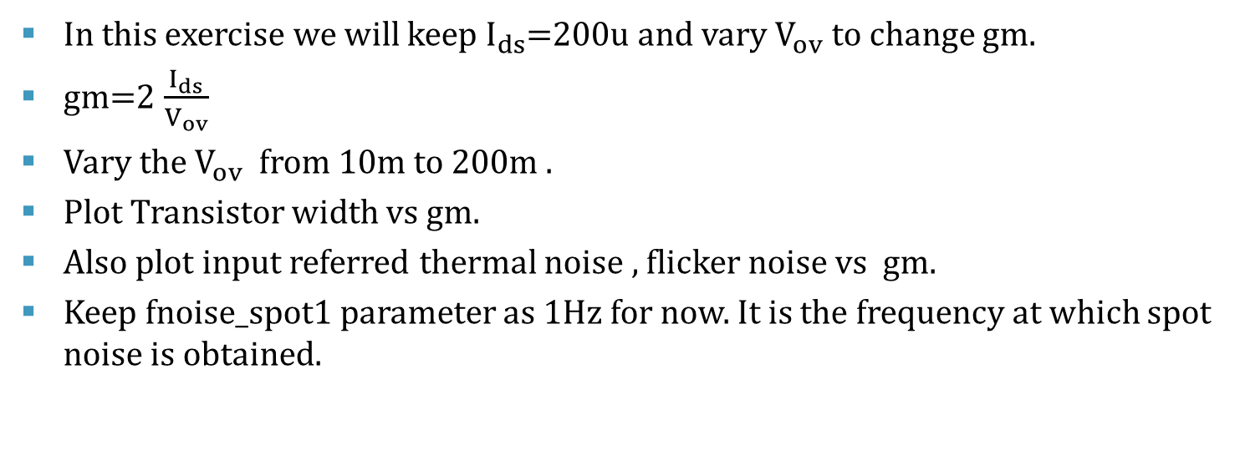
MATLAB Session1(15min)
In this exercise we will keep $I_{ds}$=200u and vary $V_{ov}$ to change gm.
gm=2 $\frac{I_{ds}}{V_{ov}}$
Vary the $V_{ov}$ from 10m to 200m .
Plot Transistor width vs gm.
Also plot input referred thermal noise , flicker noise vs gm.
Keep fnoise_spot1 parameter as 1Hz for now. It is the frequency at which spot noise is obtained.

Slide 22
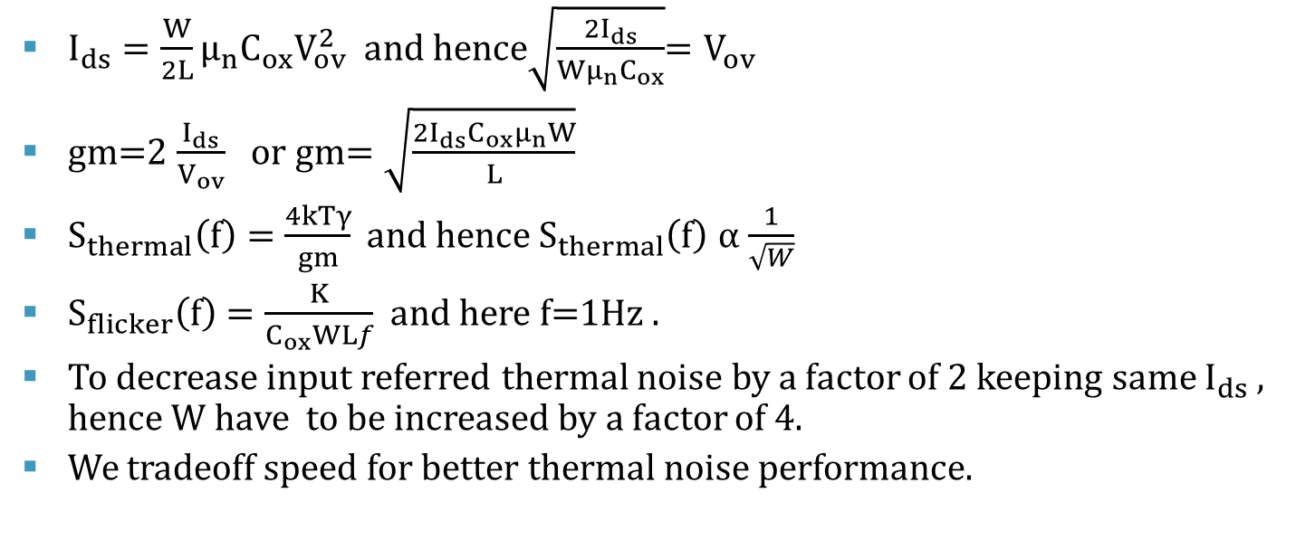
MATLAB session 1
$I_{ds}=\frac{W}{2L}μ_{n}C_{ox}V_{ov}^{2}$ and hence$\sqrt{\frac{{2I}_{ds}}{Wμ_{n}C_{ox}}}$= $V_{ov}$
gm=2 $\frac{I_{ds}}{V_{ov}}$ or gm= $\sqrt{\frac{2I_{ds}C_{ox}μ_{n}W}{L}}$
$S_{thermal}\left(f\right)=\frac{4kTγ}{gm} and hence{ S}_{thermal}\left(f\right)$ $α$ $\frac{1}{\sqrt{W}}$
$S_{flicker}\left(f\right)=\frac{K}{C_{ox}WLf}$ and here f=1Hz .
To decrease input referred thermal noise by a factor of 2 keeping same $I_{ds}$ , hence W have to be increased by a factor of 4.
We tradeoff speed for better thermal noise performance.

Slide 23
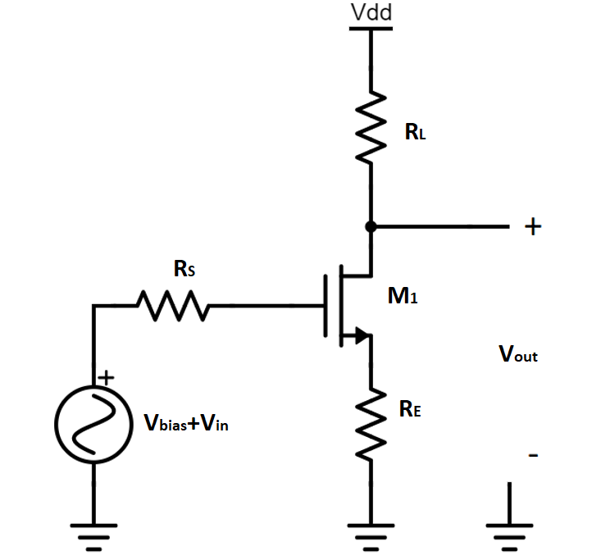
Problem 4(10 min)
Calculate output and input referred noise of the common source degenerated amplifier in the figure?
Assume transistor with infinite output impedance and trans-conductance gm.
Is the input referred noise higher or lower compared common source amplifier? Consider only thermal noise for calculations.

Slide 24
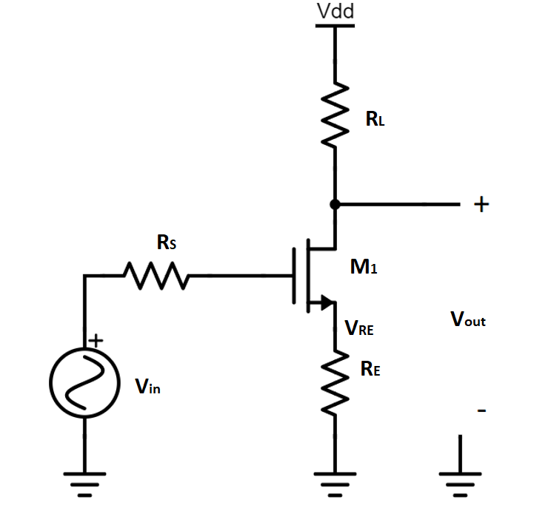
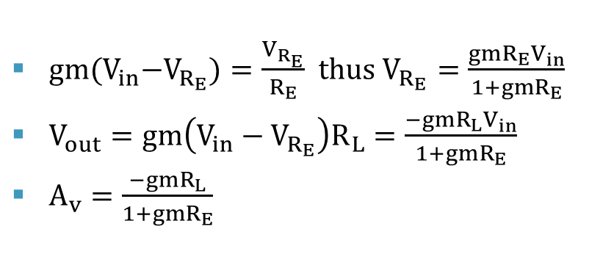

Solution 4
$gm{(V}_{in}−V_{R_{E}})=\frac{V_{R_{E}}}{R_{E}}$ thus $V_{R_{E}}=\frac{{gmR}_{E}V_{in}}{1+{gmR}_{E}}$
$V_{out}=gm\left(V_{in}−V_{R_{E}}\right)R_{L}=\frac{−{gmR}_{L}V_{in}}{1+{gmR}_{E}}$
$A_{v}=$ $\frac{−{gmR}_{L}}{1+{gmR}_{E}}$
$$gm{(V}_{in}−V_{R_{E}})$$

Slide 25
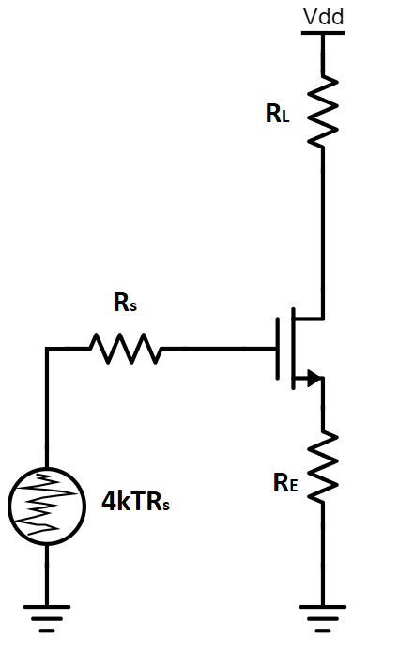
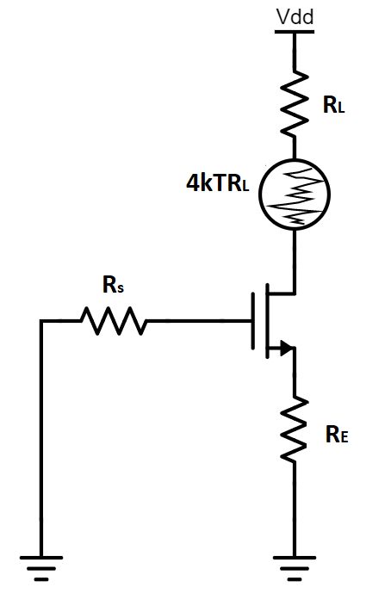

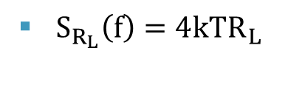


Solution 4
$$S_{R_{S}}\left(f\right)$$
$$S_{R_{L}}\left(f\right)$$
$S_{R_{L}}\left(f\right)=4{kTR}_{L}$
$S_{R_{S}}\left(f\right)=4{kTR}_{s} {\left(A_{v}\right)}^{2}$

Slide 26
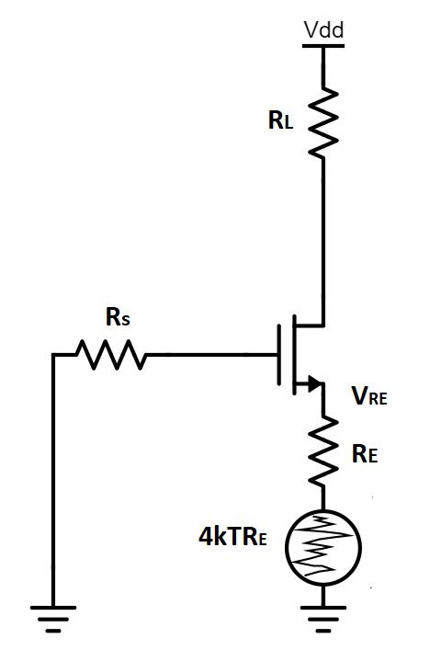

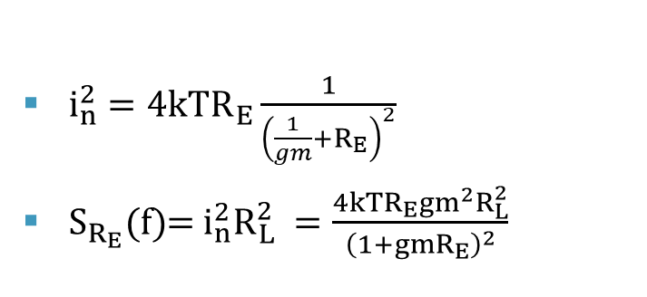
Solution 4
$i_{n}^{2}=4{kTR}_{E}\frac{1}{{\left(\frac{1}{gm}+R_{E}\right)}^{2}}$
$S_{R_{E}}(f)$= $i_{n}^{2}R_{L}^{2} =\frac{4{kTR}_{E}{gm}^{2}R_{L}^{2}}{{\left(1+gmR_{E}\right)}^{2}}$
$$i_{n}$$

Slide 27
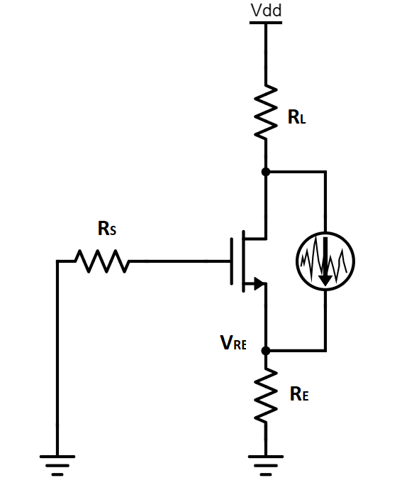





Solution 4
${gmV}_{R_{E}}+\frac{V_{RE}}{R_{E}}=i_{n}$
$V_{R_{E}}=\frac{i_{n}R_{E}}{1+gmR_{E}}$
$i_{L}$= - $\frac{i_{n}}{1+gmR_{E}}$
$S_{M1}(f)$= $i_{L}^{2}R_{L}^{2}=\frac{4kTγgmR_{L}^{2}}{{\left(1+gmR_{E}\right)}^{2}}$
$$i_{L}$$
$$gmV_{R_{E}}$$
$$S_{M1}(f)$$
$$i_{n}$$

Slide 28
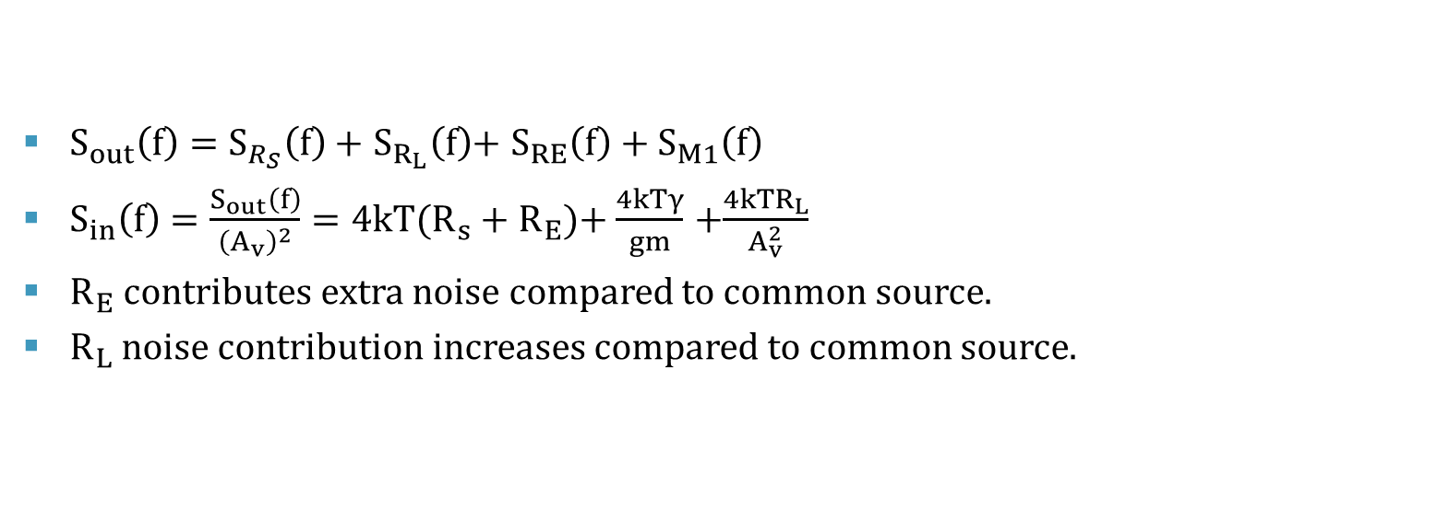
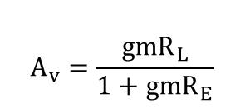
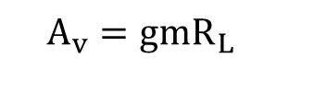
Solution 4
$$A_{v}={gmR}_{L}$$
$$A_{v}=\frac{{gmR}_{L}}{1+{gmR}_{E}}$$
$S_{out}\left(f\right)=$ $S_{R_{S}}\left(f\right)+$ $S_{R_{L}}\left(f\right)$+ ${S_{RE}\left(f\right)+S}_{M1}\left(f\right)$
$S_{in}\left(f\right)=\frac{S_{out}\left(f\right)}{{\left(A_{v}\right)}^{2}}=4{kT(R}_{s}+R_{E})$+ $\frac{4kTγ}{gm}$ +$\frac{4{kTR}_{L}}{A_{v}^{2}}$
$R_{E}$ contributes extra noise compared to common source.
$R_{L}$ noise contribution increases compared to common source.

Slide 29
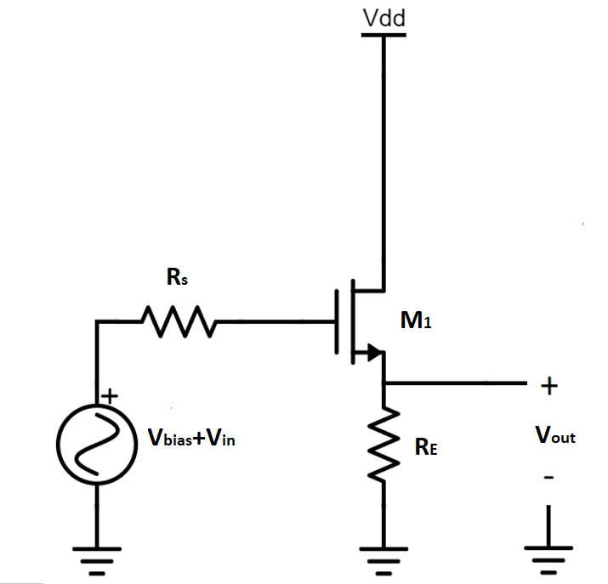
Problem 5(10 min)
Calculate output and input referred noise of the common drain amplifier in the figure?
Assume transistor with infinite output impedance and trans-conductance gm. Consider only thermal noise for calculations.

Slide 30
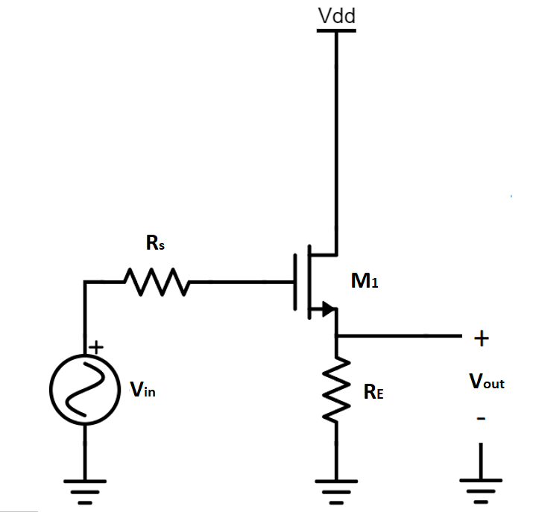
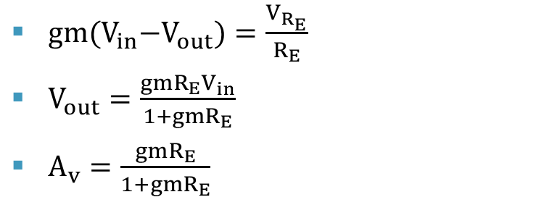
Solution 5
$gm{(V}_{in}−V_{out})=\frac{V_{R_{E}}}{R_{E}}$
$V_{out}=\frac{{gmR}_{E}V_{in}}{1+{gmR}_{E}}$
$A_{v}=\frac{{gmR}_{E}}{1+{gmR}_{E}}$

Slide 31
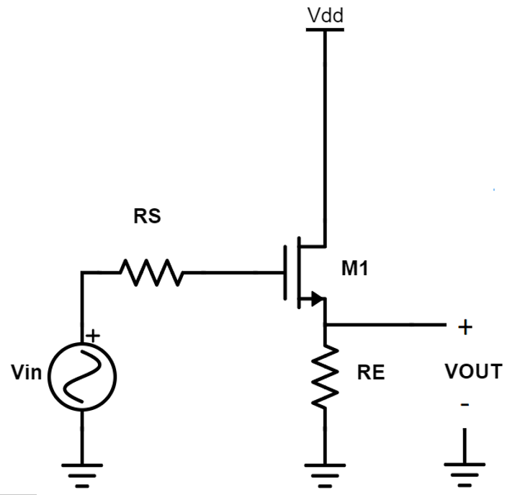

Solution 5
$S_{R_{S}}\left(f\right)=$ $4{kTR}_{s}{\left(A_{v}\right)}^{2}$
$S_{M1}\left(f\right)=$ $\frac{4kTγ}{gm}{\left(A_{v}\right)}^{2}$
Resistor $R_{E}$ noise attenuated by a factor of $\frac{1}{1+{gmR}_{E}}$
$S_{R_{E}}\left(f\right)=4{kTR}_{E}$ $\frac{1}{{\left(1+{gmR}_{E}\right)}^{2}}$
$S_{out}\left(f\right)=$ $S_{R_{S}}\left(f\right)$+ ${S_{R_{E}}\left(f\right)+S}_{M1}\left(f\right)$
$S_{in}\left(f\right)=\frac{S_{out}\left(f\right)}{{\left(A_{v}\right)}^{2}}=4{kTR}_{s}+\frac{4kTγ}{gm}$ +$\frac{4{kTR}_{L}}{{\left({gmR}_{E}\right)}^{2}}$

Slide 32

Problem 6.1(10 min)
Calculate the input referred noise of the cascaded common source amplifier as shown in the figure. ? The transistors M1 and M2 have trans-conductance gm₁ and gm₂. Assume only thermal noise and neglect the flicker noise of transistors.
Also assume infinite output impedance of the transistors with all transistors in saturation.

Slide 33


Solution 6.1
$A_{v1}={gm}_{1}R_{L1}$ and $A_{v2}={gm}_{2}R_{L2}$
$S_{R_{S}}\left(f\right)=4{kTR}_{s}$ ${\left(A_{v1}A_{v2}\right)}^{2}$
$S_{M1}\left(f\right)=\frac{4kTγ}{{gm}_{1}}{\left(A_{v1}A_{v2}\right)}^{2}$
$S_{R_{L1}}\left(f\right)=4{kTR}_{L1}$ ${\left(A_{v2}\right)}^{2}$
$S_{M2}\left(f\right)=\frac{4kTγ}{{gm}_{2}}{\left(A_{v2}\right)}^{2}$
$S_{{R_{L}}_{2}}\left(f\right)=$ $4{kTR}_{L_{2}}$
$S_{out}\left(f\right)$= $S_{R_{S}}\left(f\right)$+ $S_{M_{1}}\left(f\right)$+ $S_{R_{L1}}\left(f\right)$+ $S_{M_{2}}\left(f\right)$+ $S_{R_{L2}}\left(f\right)$

Slide 34

Solution 6.1
$S_{in}\left(f\right)=\frac{S_{out}\left(f\right)}{{\left(A_{v1}A_{v2}\right)}^{2}}=4{kTR}_{s}+\frac{4kTγ}{{gm}_{1}}$ +$\frac{4{kTR}_{L1}}{{\left(A_{v1}\right)}^{2}}$ + $\frac{4kTγ}{{gm}_{2}{\left(A_{v1}\right)}^{2}}$ + $\frac{4{kTR}_{L2}}{{\left(A_{v1}A_{v2}\right)}^{2}}$

Slide 35
Problem 6.2
What are the noise sources contributing most of the noise .
From the expression you will see that in order to decrease the noise contribution of the second stage you can increase the gain of the first stage. Is their any limit (Consider channel length modulation and hence finite output impedance)? Any technique you can try to overcome the limit ?

Slide 36

Solution 6.2
$S_{in}\left(f\right)=4{kTR}_{s}+\frac{4kTγ}{{gm}_{1}}$ +$\frac{4{kTR}_{L1}}{{\left(A_{v1}\right)}^{2}}$ + $\frac{4kTγ}{{gm}_{2}{\left(A_{v1}\right)}^{2}}$ + $\frac{4{kTR}_{L2}}{{\left(A_{v1}A_{v2}\right)}^{2}}$
Noise of second stage transistor suppressed by gain of the first stage.
Hence ,first stage noise usually dominates noise performance in cascaded amplifier.
First stage gain limited by finite output impedance or channel length modulation.
Cascoding, can be used to increase first stage gain.

Slide 37



Solution 6.2
$$A_{v}=\frac{gmRr_{o}}{R+r_{o}}$$
$$A_{vmax}=gmr_{o}$$
First stage gain limited by finite output impedance or channel length modulation.
Cascoding, can be used to increase first stage gain.

Slide 38

Problem 6.3(10 min)
Now add capacitance CL₁ to the output of the first stage. How will it change the input referred noise contribution of the second stage with frequency?

Slide 39

Solution 6.3
$A_{v1}=\frac{{{gm}_{1}R}_{L1}}{1+sC_{L1}R_{L1}}$ ,${|A}_{v1}{\left.​\right|}^{2}=$ $\frac{{{gm}_{1}^{2}R}_{L1}^{2}}{1+ω^{2}C_{L1}^{2}R_{L1}^{2}}$
$A_{v2}=gm_{2}R_{L2}$
$S_{R_{S}}\left(f\right)=4{kTR}_{s}{|A}_{v1}{\left.​\right|}^{2}{|A}_{v2}{\left.​\right|}^{2}$
$S_{M1}\left(f\right)=\frac{4kTγ}{{gm}_{1}}$ ${|A}_{v1}{\left.​\right|}^{2}{|A}_{v2}{\left.​\right|}^{2}$
$S_{R_{L1}}\left(f\right)=\frac{4{kTR}_{L1}}{1+ω^{2}C_{L1}^{2}R_{L1}^{2}}{|A}_{v2}{\left.​\right|}^{2}$
$S_{M2}\left(f\right)=\frac{4kTγ}{{gm}_{1}}{|A}_{v2}{\left.​\right|}^{2}$
$S_{{R_{L}}_{2}}\left(f\right)=$ $4{kTR}_{L2}$
$S_{out}\left(f\right)$= $S_{R_{S}}\left(f\right)$+ $S_{M_{1}}\left(f\right)$+ $S_{R_{L1}}\left(f\right)$+ $S_{M_{2}}\left(f\right)$+ $S_{R_{L2}}\left(f\right)$

Slide 40




Solution 6.3
$${|A}_{v1}{\left.​\right|}^{2}$$
$${|A}_{v2}{\left.​\right|}^{2}$$
f
f
$$S_{in}(f)$$
$S_{in}\left(f\right)=\frac{S_{out}\left(f\right)}{{\left({|A}_{v1}||A_{v2}|\right)}^{2}}=4{kTR}_{s}+\frac{4kTγ}{{gm}_{1}}$ +$\frac{4{kTR}_{L1}}{{\left({{gm}_{1}R}_{L1}\right)}^{2}}$ + $\frac{4kTγ}{{gm}_{2}{\left({|A}_{v1}|\right)}^{2}}$ + $\frac{4{kTR}_{L2}}{{\left({|A}_{v1}||A_{v2}|\right)}^{2}}$
f

Slide 41


Problem 7.1(15 min)
Figure shows common source amplifier with total input capacitance $C_{in}$. In the figure, R_{L}=5kΩ, R_{S}=100kΩ , $C_{in}$=33fF and gm=1mS.
For transistor M1 drain flicker noise current spectral density at 1Hz=${5∗10}^{−15} A^{2}$/Hz.
Plot the output and input referred noise voltage spectral density with frequency in MATLAB. In this question consider both thermal and flicker noise contribution ? Take γ=2/3.

Slide 42




Solution 7.1
$V_{g}=\frac{V_{in}}{1+{sC}_{in}R_{s}}$
$V_{out}=$ $−gmV_{g}R_{L}$
$V_{out}=\frac{{−{gmR}_{L}V}_{in}}{1+{sC}_{in}R_{s}}$ thus $A_{v }=\frac{−gmR_{L}}{1+{sC}_{in}R_{s}}$
${|A}_{v}{\left.​\right|}^{2}=$ $\frac{{{gm}^{2}R}_{L}^{2}}{1+ω^{2}C_{in}^{2}R_{S}^{2}}$
$$V_{g}$$
$${gmV}_{g}$$

Slide 43














Solution 7.1
$$R_{L}$$
$$R_{L}$$
$$S_{R_{S}}\left(f\right)$$
$${4kTR}_{L}$$
$$S_{R_{L}}\left(f\right)$$
$$R_{S}$$
$$R_{S}$$
$$C_{in}$$
$$C_{in}$$
$${4kTR}_{S}$$
$S_{R_{S}}\left(f\right)=4{kTR}_{s}$ ${\left({|A}_{v}|\right)}^{2}$
$S_{R_{L}}\left(f\right)=4{kTR}_{L}$

Slide 44





Solution 7.1
$S_{M1}=i_{n}^{2}R_{L}^{2}=4{kTγgmR}_{L}^{2}$
$S_{thermal}\left(f\right)=4{kTR}_{s}$ ${\left({|A}_{v}|\right)}^{2}$+$4{kTγgmR}_{L}^{2}+4{kTR}_{L}$
$S_{flicker}\left(f\right)$= $i_{f}^{2}R_{L}^{2}$ where $i_{f}^{2} =\frac{{10}^{−15}}{f}\frac{A^{2}}{Hz}$
$S_{total}\left(f\right)=S_{flicker}\left(f\right)$+ $S_{thermal}\left(f\right)$
$S_{in}\left(f\right)=\frac{S_{total}\left(f\right)}{{|A}_{v}^{2}|}$
Using the values given in the question we can plot the noise contribution.
$$R_{L}$$
$$S_{R_{S}}\left(f\right)$$
$$R_{S}$$
$$i_{n}$$
$$C_{in}$$

Slide 45

Solution 7.1

Slide 46

Solution 7.1

Slide 47
Problem 7.2(5 min)
The input signal bandwidth is from 10MHz to 100MHz ? Calculate the input referred integrated noise in the given bandwidth and minimum detectable signal value ?

Slide 48

Solution 7.2
$S_{in}\left(f\right)=\frac{S_{in}\left(f\right)}{|A_{v}^{2}| } and {|A}_{v}{\left.​\right|}^{2}= \frac{{{gm}^{2}R}_{L}^{2}}{1+ω^{2}C_{gs}^{2}R_{S}^{2}}$
Input referred noise dominated by source resistor $R_{S}.$
Source resistor noise 4kT$R_{S}=1.65∗{10}^{−15}$ $\frac{{ V}^{2}}{Hz}$
Input referred integrated noise in 90MHz band $\overline{V_{n}^{2}}$=4kT$R_{S}$B=$1.5∗{10}^{−7} V^{2}$
Rms integrated noise = $\sqrt{1.5∗{10}^{−7}}$=0.39mV rms which is minimum detectable signal.

Slide 49

PROBLEM 8.1(10 min)
Figure shows a different pair. Transistor M1 and M2 have trans-conductance gm. Assuming bias current from transistor M3 does not add any noise. What is total input referred noise of the differential pair ? Consider only thermal noise.

Slide 50












Solution 8.1
$$R$$
$$R$$
$$R$$
$$R$$
$$\frac{{gmV}_{in}}{2}$$
+
-
$$\frac{{gmV}_{in}}{2}$$
$$\frac{V_{in}}{2}$$
$$\frac{{−V}_{in}}{2}$$
$$V_{bias}$$
$$V_{bias}$$
$A_{v}={−gmR}_{L}$
$S_{R}(f)$=8kTR

Slide 51











Solution 8.1
$2gmv_{s}=i_{n}$ thus $gmv_{s}=\frac{i_{n}}{2}$
$v_{on}={−i}_{n}R$
Hence, $S_{M1}(f)$=$S_{M2}(f)$=$i_{n}^{2}R^{2}=4kTγgmR^{2}$
$S_{out}(f)$= $8kTγgmR^{2}+8kTR$
$S_{in}(f)$= $\frac{S_{out}\left(f\right)}{{{gm}^{2}R}^{2} }$= $\frac{8kTγ}{gm}+\frac{8kTR}{gm^{2}R^{2}}$
$$R$$
$$R$$
$$gmv_{s}−i_{n}$$
$$+$$
$$v_{on}$$
$$−$$
$$gmv_{s}$$
$$i_{n}$$
$$gmv_{s}$$
$$v_{s}$$
$$gmv_{s}$$
$$gmv_{s}$$
$$V_{bias}$$

Slide 52

PROBLEM 8.2(5 min)
Now imagine transistor M3 adds noise. Do you think it will add noise to the differential output? Can flicker noise in M3 change the gain of the amplifier with time ?
What do you think will be the impact of noise in supply Vdd ?

Slide 53




Solution 8.2
Noise added by $M_{3}$ common mode if the input signal is small. Some exceptions exists like Mixers and Oscillators.
Flicker noise in $M_{3}$ can be thought of as very slow fluctuating current.
Hence flicker noise in $M_{3}$ will slowly vary gm of differential pair and hence the gain.
$$\frac{i_{n}}{2}$$
$$\frac{i_{n}}{2}$$
$$i_{n}$$

Slide 54


Solution 8.2
Fluctuations in $V_{dd}$ are common mode.

Slide 55


Problem 9(10 min)
The figure A shows trans-impedance amplifier. Trans-impedance amplifier converts input current to voltage.
It can be built by using ideal op-amp with very high gain A and feedback resistor.
Assuming input referred noise of the op-amp used is $\overline{V_{amp}^{2}}$. Derive an expression of input referred noise in terms of noise of resistor R_{F} and op-amp noise $\overline{V_{amp}^{2}}$ ?

Slide 56

Problem 9
Transimpedance gain = $R_{F}.$

Slide 57


Solution 9
A($V_{amp}−V_{o})=V_{o}$
$V_{o}$=A $\frac{V_{amp}}{1+A}$
For very high gain $V_{o}$= $V_{n}.$
And hence $\overline{V_{o}^{2}}$= $\overline{V_{amp}^{2}}$

Slide 58


Solution 9
-A($V_{out}+V_{RF})=V_{out}$
Again for high gain condition $\overline{V_{o}^{2}}$= $\overline{V_{RF}^{2}}.$
Total output noise $\overline{V_{o}^{2}}$= $\overline{V_{RF}^{2}}$ + $\overline{V_{amp}^{2}}$
$\overline{I_{n}^{2}}$= $\overline{V_{RF}^{2}}/R_{F}^{2}$ + $\overline{V_{amp}^{2}}/R_{F}^{2}$

Slide 59

Problem 10.1(10 min)
Calculate the input referred noise contribution at low frequencies from the transistors M_{1A} , M_{1B} , M_{2A} and M_{2B}? Assume the trans-conductance of transistors M_{1A} and M_{1B} is gm_{n} and trans-conductance of M_{2A} and M_{2B} is gm_{p}.
Consider only thermal noise of the transistors. Low frequency means frequencies much less that the dominant pole.

Slide 60










Solution 10.1
$A_{V}={gm}_{n}{ R}_{o}$
$$\frac{{gm_{n}V}_{in}}{2}$$
$$\frac{{gm_{n}V}_{in}}{2}$$
$$gm_{n}V_{in}$$
$$R_{o}$$
$$\frac{V_{in}}{2}$$
$$\frac{{gm_{n}V}_{in}}{2}$$
$$\frac{{−V}_{in}}{2}$$
$$\frac{{gm_{n}V}_{in}}{2}$$
$$V_{bias}$$

Slide 61










Solution 10.1
${V_{on}=i}_{n}R_{o}$
$i_{n}^{2}=4kTγgm$
$S_{M_{1A}}(f)=$ $i_{n}^{2}R_{o}^{2}=4kTγ{gm}_{n}R_{o}^{2}$
Similarly $S_{M_{1B}}(f)=4kTγ{gm}_{n}R_{o}^{2}$
$$i_{n}/2$$
$$i_{n}/2$$
$${V_{on}=i}_{n}R_{o}$$
$$R_{O}$$
$$i_{n}$$
$$i_{n}/2$$
$$gm_{n}v_{s}$$
$$i_{n}/2$$
$$v_{s}$$

Slide 62










Solution 10.2
$$\frac{i_{n}gm_{p}}{gm_{p}}$$
$$i_{n}$$
$$i_{n}$$
$$\frac{i_{n}}{gm_{p}}$$
$$i_{n}$$
$$R_{O}$$
$$i_{n}$$
$$R_{O}$$
$S_{M_{2A}}(f)=4kTγ{gm}_{p}R_{o}^{2}$
$S_{M_{B}}(f)=4kTγ{gm}_{p}R_{o}^{2}$

Slide 63

Solution 10.1
$S_{out}=S_{M1A}+{S_{M2A}+S_{M2A}+S}_{M2B}$
$S_{in}$(f)= $\frac{S_{out}\left(f\right)}{A_{V}^{2}}$= $\frac{8kTγ}{{gm}_{n}}$+ $\frac{8kTγgm_{p}}{gm_{n}^{2}}$

Slide 64
Problem 10.2(HW)
Can you comment on noise contribution of transistors M₃ and M₄ at very low frequencies.
At what frequency approximately will the 2nd stage noise will begin to dominate? Take low frequency output impedance of first and second as R_{o1} and R_{o2}. (Hint this frequency to first order is the frequency where the gain of the first stage approximately drops to 1)

Slide 65

Solution 10.2
Noise contribution of M₃ and M₄ suppressed by gain of first stage .
Output gain of the first stage of the OTA = $\frac{gm_{n}R_{o1}}{1+sC_{c}gm_{3}R_{o1}R_{o2}}$
f(A_{v} =1)=$\frac{gm_{n}}{2πgm_{3}C_{c}R_{o2}}$

